Slide 1
Order Management Microservices/Kafka Project
Hanane Maguer

Slide 2
About me
  Hanane Maguer
  Education:
    Bachelor Degree in computer sciences.
    Master Degree in computer sciences.
    Microservices and Kafka Training.
    Full Stack Software Developer training.
    MS-SQL database administration certificate.
  Work:
    Software Developer, BRPM.
    Software Developer, VILETE.
    SQL instructor, Alamia Private School.
    Technical support, TTEC.

Slide 3
Background
Application main flow
Admin
Add
Customer
Add
View
Products
view
Add
order
Order by customer
Orders list

Slide 4
Background
What is Order Management?
  Order Management web application.
  Admin posts products.
  Customer displays products.
  Customer makes an order.
  Admin displays and manages orders from different customers.
  Kafka Producer publish Order Management Application activities to order activity topic on the broker.
  Kafka Consumer subscribe to order activity topic and write it to a log file.
  Kafka Producer publish order event to order event topic on the broker.
  Kafka Consumer subscribe to order event topic and send email notification on successful order creation or cancellation to the customer.

Slide 5
Goals
Two main roles admin, customer.
After login, each user will be forwarded to a specific principal web page based on his role.
Each role is allowed/restricted to/from actions.

Slide 6
Application Architecture
Discovery server
Circuit breaker
db
db
db
Product microservice
Customer microservice
Order microservice
Testing
Mockito
Angular
SpringBoot
REST API
HTTP
CI/CD
Jenkins
Cloud
Connecting microservices
HTTP(Sync)/Messaging(Async)
Kafka producer microservice
Kafka consumer microservice
Kafka Broker
Messaging
Mail/Log

Slide 7
Functionality
Admin login page
Application principal page with login option.
Two sub-principal pages: admin page and customer page.
Username
Password
login
Welcome to order management Page
Customer login page
Select user type
Admin Login
Username
Customer Login
Password
login
If you don’t have an account please sign up here
Sign up

Slide 8
Functionality/Admin
Add Customer
List Customers
Update/Delete Customer
Dashboard
Add Product
List Products
Update/Delete Product
Logout
Order List
Product Name
delete
update
Username
Customers list
Unit price
Address
Qte
Password
add
Email id
Phone number
Products list
delete
update
add
Product details
update
Customer details
update
Orders list
details
Orders details/ all products

Slide 9
Functionality/User
Dashboard
Order List
Logout
List Products
Products lis
Add order
Orders list
update
Qte
Upload Gift
Upload
Create order
Orders details/ all products
delete
update
Notify customer by email
(Kafka Consumer)
Cancel order

Slide 10
Application API endpoints
URI | HTTP method | REST controller method | Method description
/order_manage/customers/ | GET | getAllCustomers() | Fetches details of all customers.
/order_manage/customers/{id} | GET | getCustomerById(long id) | Fetches details of customer based on it’s id.
/order_manage/customers/ | POST | addCustomer(Customer customer) | Adds customer.
/order_manage/customers/{id} | PUT | updateCustomer(long id,Customer customer) | Updates customer details based on it’s id.
/order_manage/customers/{id} | DELETE | deleteCustomer(long id,Customer customer) | Deletes customer based on it’s id.
/order_manage/products/ | GET | getAllProducts() | Fetches details of all products.
/order_manage/products/{id} | GET | getProductById(long id) | Fetches details of product based on it’s id.
/order_manage/products/ | POST | addProduct (Product product) | Adds product.
/order_manage/products/{id} | PUT | updateProduct (long id, Product product) | Updates product details based on it’s id.
/order_manage/products/{id} | DELETE | deleteProduct (long id, Product product) | Deletes product based on it’s id.

Slide 11
Application API endpoints(continue)
URI | HTTP method | REST controller method | Method description
/order_manage/orders/ | GET | getAllOrders() | Fetches details of all orders.
/order_manage/orders/{id} | GET | getOrderById(long id) | Fetches details of order based on it’s id.
/order_manage/orders/ | POST | addOrder(Order order) | Adds order.
/order_manage/orders/{id} | PUT | updateOrder(long id, Order order) | Updates customer details based on it’s id.
/order_manage/orders/{id} | DELETE | deleteOrder(long id, Order order) | Deletes customer based on it’s id.
/order_manage/orders/cust_prod/{id} | GET | getOrderCustomerDepartment(long id) | Fetches details of order based on it’s id with it’s customer and product details.

Slide 12
Application API endpoints(continue)
URI | HTTP method | REST controller method | Method description
/order_manage/order_events/publish/{status} | POST | publishOrderEvent(Order order) | Publish order event into Kafka broker
consumer | / | consume(OrderEvent orderEvent) | Consume order event topic messages from Kafka broker and send notification email to customer.
/order_manage/order_activities/publish | POST | publishOrderActivity(String activity) | Publish order activity into Kafka broker
consumer | / | consume(String activity) | Consume order activity topic messages from Kafka broker and write to a log file.

Slide 13
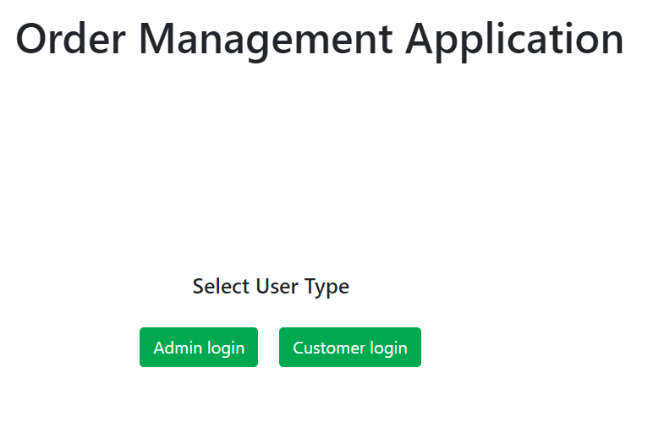
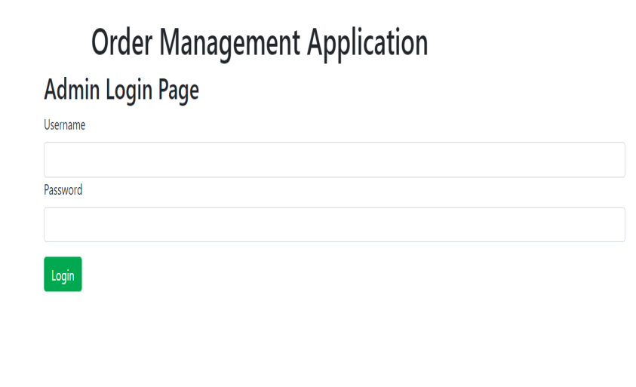
Functionality/Admin Login
Select User type and login as admin

Slide 14
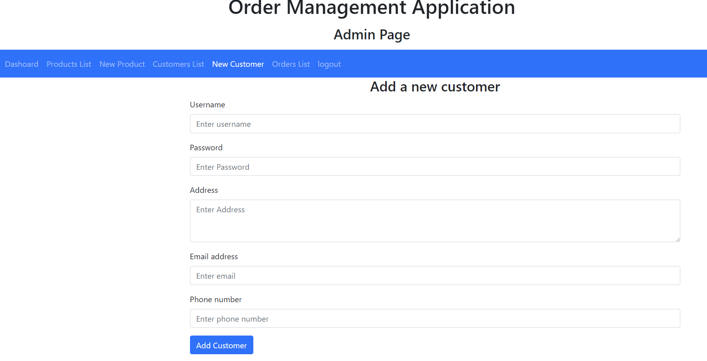
Functionality/Admin page
This page used by an admin to
add, delete, modify, and list :
  Customers
  Products
  Orders

Slide 15
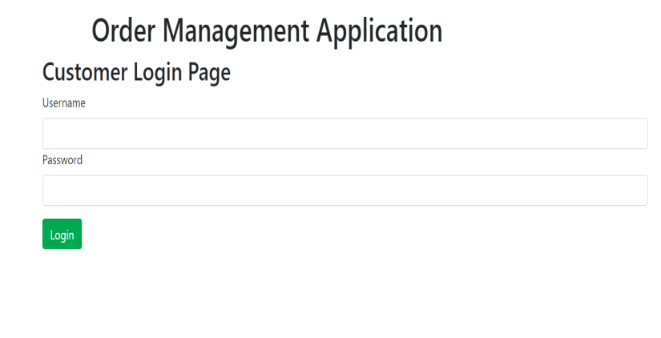
Functionality/Customer login
Select user type and login as customer

Slide 16
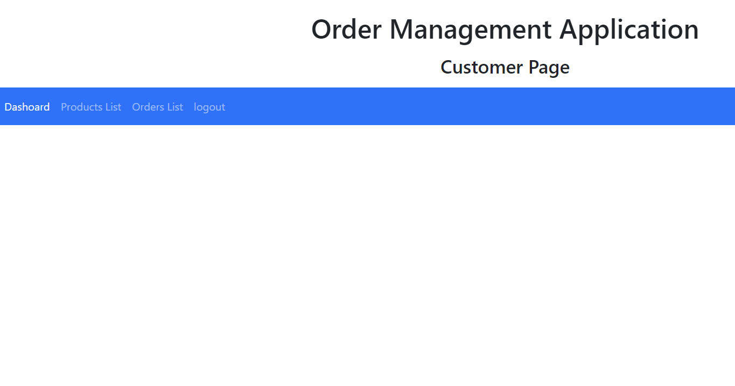
Functionality/Customer page
This page used by a customer to add, modify, delete and list :
  His Orders.

Slide 17
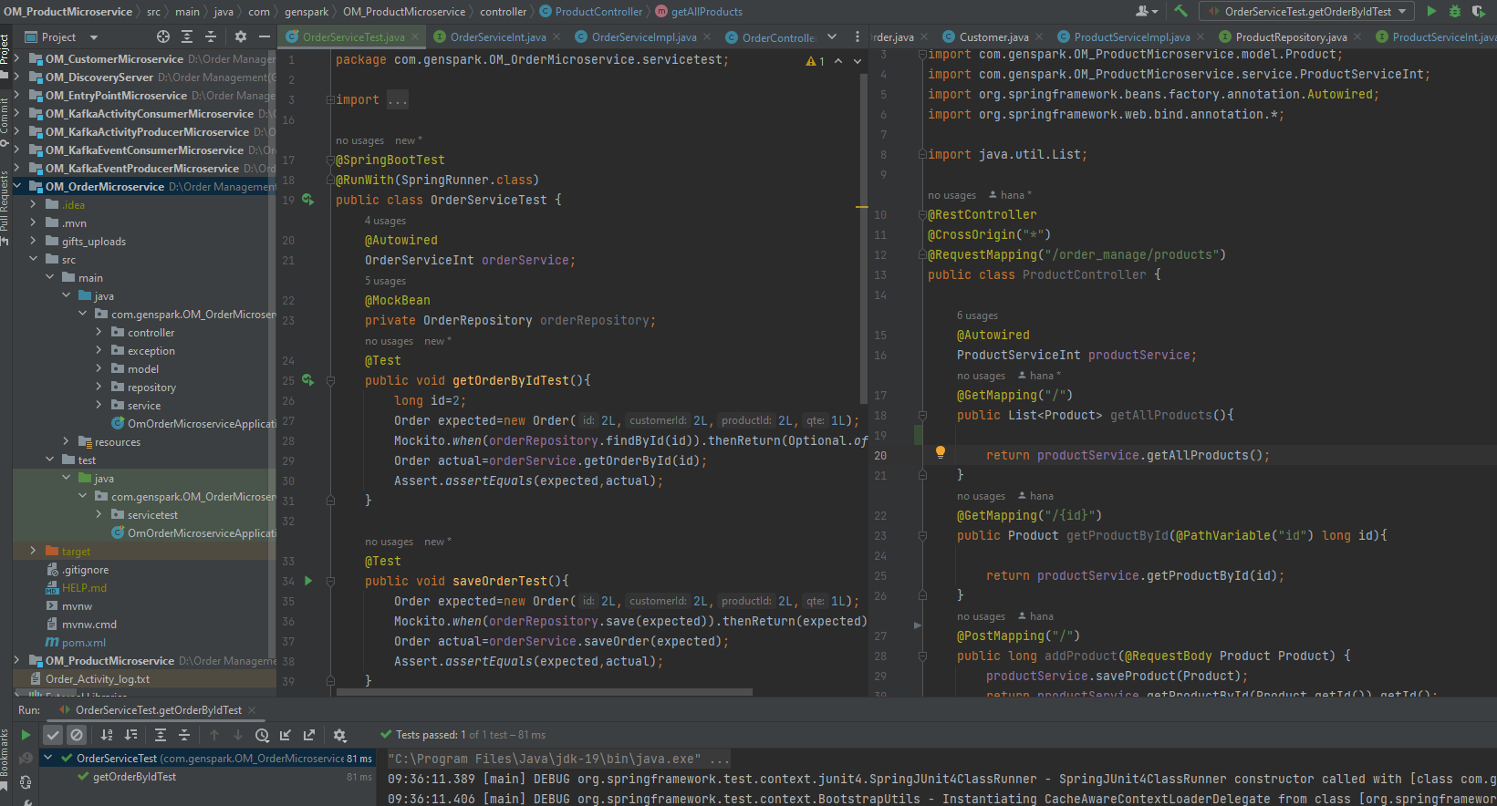
Project Structure

Slide 18
Challenges
Angular

Slide 19










Used technologies

Slide 20
What’s next
Add security module.
Add online secure payment.
Allowed admin to upload product’s image.
Display orders images in the application’s main page with sliding option.

Slide 21
Questions?

